Slide 1

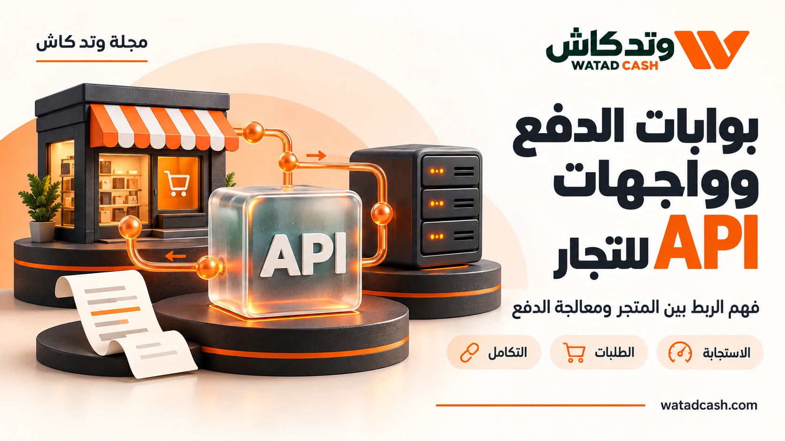
Digital Financial Services: A Business Payment Map
Keep customer payments, card funding, transfer costs and service activation distinct in a practical small-business payment map.
watadcash.com
01
Notes:
WATADCASH editorial adaptation. Source review: 2026-10-18.
Availability and fees depend on the actual route and current terms.
WATADCASH gateway services: https://watadcash.com/gateway.php
WATADCASH card pricing: https://watadcash.com/watadcash-card.php
WATADCASH internal transfers: https://watadcash.com/internal-transfers.php
WATADCASH merchant payment documentation: https://watadcash.com/documentation/payments/

Slide 2
Start with the outcome you need
A small business can use several financial services while still thinking of all money as one balance. That shortcut becomes difficult when an activation fee, customer payment, card funding request and transfer to a supplier appear in the same week. WATADCASH’s public catalogue includes several of these activities, but its pages explain that they have different purposes and conditions. A simple payment map helps a business understand which amount belongs to which job.
watadcash.com
02
Notes:
WATADCASH editorial adaptation. Source review: 2026-10-18.
Availability and fees depend on the actual route and current terms.
WATADCASH gateway services: https://watadcash.com/gateway.php
WATADCASH card pricing: https://watadcash.com/watadcash-card.php
WATADCASH internal transfers: https://watadcash.com/internal-transfers.php
WATADCASH merchant payment documentation: https://watadcash.com/documentation/payments/

Slide 3
List the activities your business actually performs
Start with four plain questions. How do customers pay you? How do you pay for business purchases? How do you send money to other people? Which service-enablement costs do you incur? The answers describe activities, not necessarily interchangeable balances.
For example, WATADCASH’s gateway pages describe customer collection through USDT or its wallet. Its card pages describe issuance and funding, while transfer pages describe recipient routes and quotes. Put those activities on separate lines in your map. This prevents a discussion about checkout revenue from silently becoming a discussion about the amount available on a card.
watadcash.com
03
Notes:
WATADCASH editorial adaptation. Source review: 2026-10-18.
Availability and fees depend on the actual route and current terms.
WATADCASH gateway services: https://watadcash.com/gateway.php
WATADCASH card pricing: https://watadcash.com/watadcash-card.php
WATADCASH internal transfers: https://watadcash.com/internal-transfers.php
WATADCASH merchant payment documentation: https://watadcash.com/documentation/payments/

Slide 4
Distinguish enabling a service from funding it
A service activation charge and operational funding serve different purposes. WATADCASH’s public materials say gateway activation is not spendable balance and explain that card issuance and card funding are separate. If your internal worksheet labels all of these amounts simply “deposit,” it loses information the team needs.
Use a description that survives a later review. “Gateway activation,” “card issuance” and “card funding” communicate more than a generic outgoing payment label. Record the provider reference alongside your internal purpose. This is a practical recordkeeping choice, not a substitute for whatever formal accounting requirements apply to your business.
watadcash.com
04
Notes:
WATADCASH editorial adaptation. Source review: 2026-10-18.
Availability and fees depend on the actual route and current terms.
WATADCASH gateway services: https://watadcash.com/gateway.php
WATADCASH card pricing: https://watadcash.com/watadcash-card.php
WATADCASH internal transfers: https://watadcash.com/internal-transfers.php
WATADCASH merchant payment documentation: https://watadcash.com/documentation/payments/

Slide 5
Keep customer-payment proof connected to orders
When a customer pays, connect the payment request to the order it is intended to settle. WATADCASH’s merchant guidance recommends verifying the payment state on the server and checking signed notifications. A screenshot or browser return page does not provide the same evidence as a verified payment record.
This connection helps the business answer everyday questions. Which order is ready to deliver? Which payment is still pending? Which customer has contacted support about a reference? A payment map becomes useful when those questions can be answered without a person searching through unrelated transactions.
watadcash.com
05
Notes:
WATADCASH editorial adaptation. Source review: 2026-10-18.
Availability and fees depend on the actual route and current terms.
WATADCASH gateway services: https://watadcash.com/gateway.php
WATADCASH card pricing: https://watadcash.com/watadcash-card.php
WATADCASH internal transfers: https://watadcash.com/internal-transfers.php
WATADCASH merchant payment documentation: https://watadcash.com/documentation/payments/

Slide 6
Separate supplier transfers from internal movements
A transfer between two users inside one platform is different from a payment delivered through an outside provider, office or wallet. WATADCASH publishes a zero fee for transfers between its own users, while explaining that deposits, withdrawals and external transfers have separate costs.
Label the route in your business record. Record the recipient, currency and final offer for an external transfer rather than assuming an internal-transfer price applies. This makes it easier to assess the real cost of paying a supplier and to explain any difference between the amount the business paid and the amount the supplier received.
watadcash.com
06
Notes:
WATADCASH editorial adaptation. Source review: 2026-10-18.
Availability and fees depend on the actual route and current terms.
WATADCASH gateway services: https://watadcash.com/gateway.php
WATADCASH card pricing: https://watadcash.com/watadcash-card.php
WATADCASH internal transfers: https://watadcash.com/internal-transfers.php
WATADCASH merchant payment documentation: https://watadcash.com/documentation/payments/

Slide 7
Review the map when the business changes
A new market, product or payment method can change the journey. Revisit which service is enabled, which team controls credentials and which records support each transaction. For API-based work, WATADCASH’s documentation distinguishes permissions and resource ownership, so the operational map should identify which system performs which task.
The aim is not a complicated diagram. A small table of activities, references and responsible people can be enough. As the business grows, it creates a foundation for better support and reconciliation. The map remains valuable because it follows actual payment jobs rather than treating every service label and balance as equivalent.
watadcash.com
07
Notes:
WATADCASH editorial adaptation. Source review: 2026-10-18.
Availability and fees depend on the actual route and current terms.
WATADCASH gateway services: https://watadcash.com/gateway.php
WATADCASH card pricing: https://watadcash.com/watadcash-card.php
WATADCASH internal transfers: https://watadcash.com/internal-transfers.php
WATADCASH merchant payment documentation: https://watadcash.com/documentation/payments/

Slide 8
Is this payment map an accounting standard?
No. It is an operational aid for understanding payment activities and references. Your business may have separate accounting, tax and record-retention requirements. Use the map to organise information, then apply the professional requirements relevant to your situation.
watadcash.com
08
Notes:
WATADCASH editorial adaptation. Source review: 2026-10-18.
Availability and fees depend on the actual route and current terms.
WATADCASH gateway services: https://watadcash.com/gateway.php
WATADCASH card pricing: https://watadcash.com/watadcash-card.php
WATADCASH internal transfers: https://watadcash.com/internal-transfers.php
WATADCASH merchant payment documentation: https://watadcash.com/documentation/payments/

Slide 9
Why separate activation from funding?
They pay for different things. The reviewed WATADCASH pages distinguish enabling a gateway, issuing a card and loading card balance. Keeping those categories separate prevents a team from treating a service charge as money available for spending.
watadcash.com
09
Notes:
WATADCASH editorial adaptation. Source review: 2026-10-18.
Availability and fees depend on the actual route and current terms.
WATADCASH gateway services: https://watadcash.com/gateway.php
WATADCASH card pricing: https://watadcash.com/watadcash-card.php
WATADCASH internal transfers: https://watadcash.com/internal-transfers.php
WATADCASH merchant payment documentation: https://watadcash.com/documentation/payments/

Slide 10
What should connect a customer payment to an order?
Keep your internal order reference and the provider’s payment or invoice identifier together. Update fulfilment from verified payment evidence and retain enough information to investigate a pending or repeated notification without exposing secrets.
watadcash.com
10
Notes:
WATADCASH editorial adaptation. Source review: 2026-10-18.
Availability and fees depend on the actual route and current terms.
WATADCASH gateway services: https://watadcash.com/gateway.php
WATADCASH card pricing: https://watadcash.com/watadcash-card.php
WATADCASH internal transfers: https://watadcash.com/internal-transfers.php
WATADCASH merchant payment documentation: https://watadcash.com/documentation/payments/

Slide 11
Sources and scope
References reviewed by the WATADCASH editorial team on 18 October 2026. Availability and pricing depend on the actual request and current terms; this guide is not a promise of universal access.
WATADCASH gateway services
WATADCASH card pricing
https://watadcash.com/gateway.php
https://watadcash.com/watadcash-card.php
WATADCASH internal transfers
WATADCASH merchant payment documentation
https://watadcash.com/internal-transfers.php
https://watadcash.com/documentation/payments/
watadcash.com
11
Notes:
WATADCASH editorial adaptation. Source review: 2026-10-18.
Availability and fees depend on the actual route and current terms.
WATADCASH gateway services: https://watadcash.com/gateway.php
WATADCASH card pricing: https://watadcash.com/watadcash-card.php
WATADCASH internal transfers: https://watadcash.com/internal-transfers.php
WATADCASH merchant payment documentation: https://watadcash.com/documentation/payments/

Slide 12
Review the decision before confirmation
What outcome do you need?
Who is responsible for delivery?
What are the total cost and net amount?
What proves completion?
How will you follow an exception?
https://watadcash.com/journal/en/small-business-payment-balance-map/
watadcash.com
12
Notes:
WATADCASH editorial adaptation. Source review: 2026-10-18.
Availability and fees depend on the actual route and current terms.
WATADCASH gateway services: https://watadcash.com/gateway.php
WATADCASH card pricing: https://watadcash.com/watadcash-card.php
WATADCASH internal transfers: https://watadcash.com/internal-transfers.php
WATADCASH merchant payment documentation: https://watadcash.com/documentation/payments/

