Slide 1

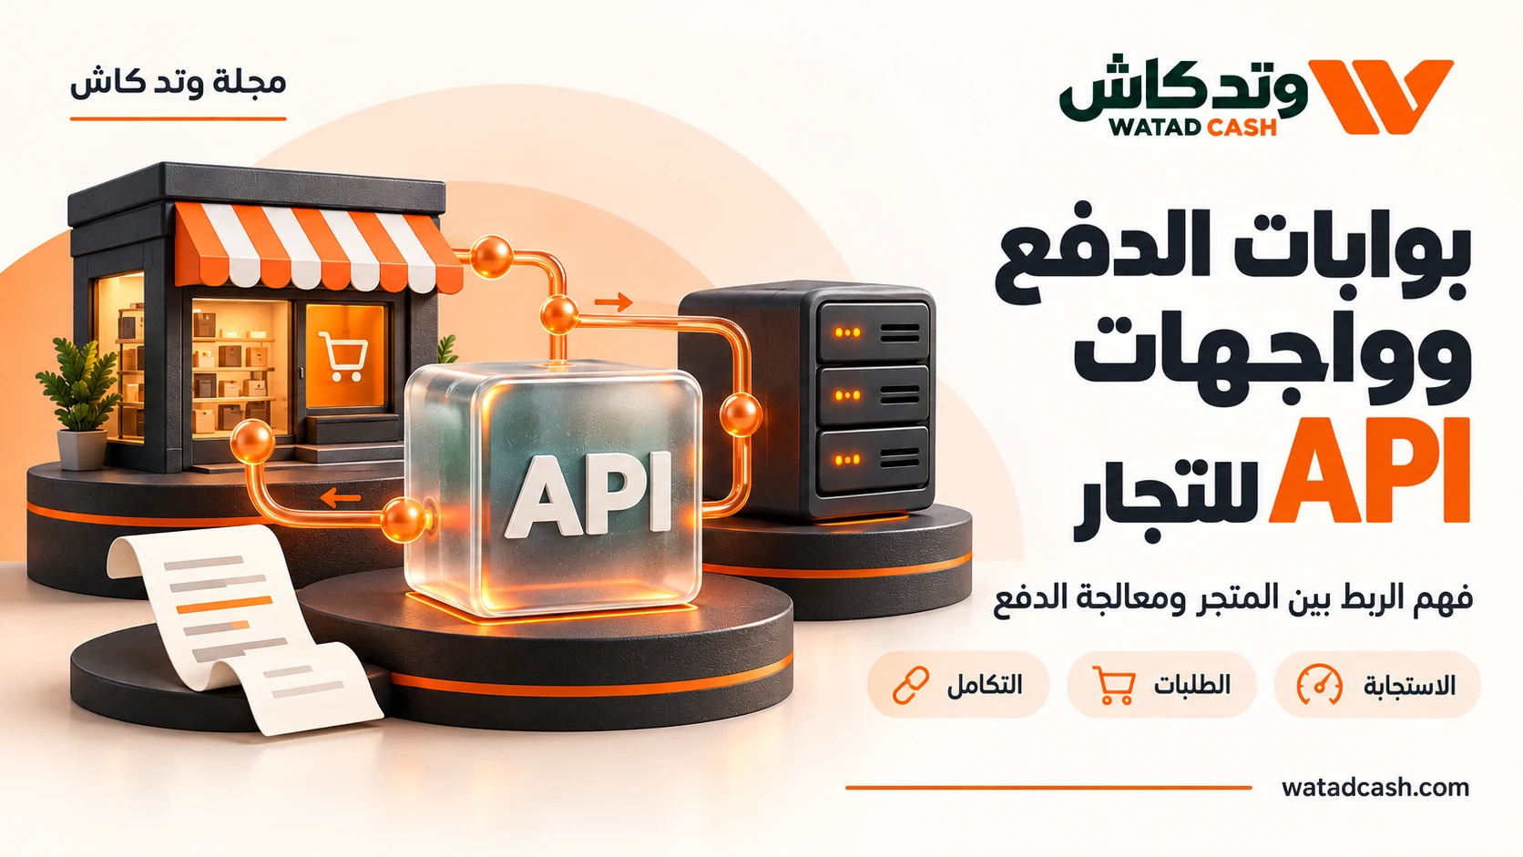
WATADCASH for Merchants: Payment Proof Before Fulfilment
Design order fulfilment around verified payment status rather than screenshots, redirects or invoice creation alone.
watadcash.com
01
Notes:
WATADCASH editorial adaptation. Source review: 2026-10-18.
Availability and fees depend on the actual route and current terms.
How a WATADCASH USDT gateway works: https://watadcash.com/gateway.php
WATADCASH payment documentation: https://watadcash.com/documentation/payments/
WATADCASH webhook documentation: https://watadcash.com/documentation/webhooks/

Slide 2
Start with the outcome you need
A customer can complete a convincing-looking checkout journey while the merchant still lacks confirmed payment. A browser redirect, a screenshot and a newly created invoice each tell part of a story, but none should automatically release an order. WATADCASH’s gateway guidance places verification on the merchant’s server and distinguishes an invoice from a confirmed paid state. That distinction is valuable for a digital download, a service booking and a physical shipment alike.
watadcash.com
02
Notes:
WATADCASH editorial adaptation. Source review: 2026-10-18.
Availability and fees depend on the actual route and current terms.
How a WATADCASH USDT gateway works: https://watadcash.com/gateway.php
WATADCASH payment documentation: https://watadcash.com/documentation/payments/
WATADCASH webhook documentation: https://watadcash.com/documentation/webhooks/

Slide 3
Connect the order and the invoice
Give each order a clear internal reference and store the payment invoice identifier beside it. The connection should survive a customer closing the browser or asking support from another device. If a payment notification arrives later, the merchant needs to know which order it belongs to without asking the customer to reconstruct the checkout session.
WATADCASH describes creating a USDT invoice or a wallet payment request through its API. These are separate payment routes with their own instructions. Show the details belonging to the current request, including the relevant network, amount and expiry where supplied. Reusing a display from an older order can make both reconciliation and customer support unnecessarily difficult.
watadcash.com
03
Notes:
WATADCASH editorial adaptation. Source review: 2026-10-18.
Availability and fees depend on the actual route and current terms.
How a WATADCASH USDT gateway works: https://watadcash.com/gateway.php
WATADCASH payment documentation: https://watadcash.com/documentation/payments/
WATADCASH webhook documentation: https://watadcash.com/documentation/webhooks/

Slide 4
Define the state that permits delivery
Write down the payment state that your system must verify before fulfilment. Your customer-facing order can show “awaiting payment” or a similar accurate status while verification is pending. The important point is that the shipping, download or service activation decision comes from the verified payment record, not from the customer reaching a thank-you page.
The WATADCASH gateway guide explicitly says that a screenshot, browser redirect or invoice-creation response is not proof that an order has been paid. This is an operational rule, not a criticism of customers. It gives every customer the same clear path from payment to delivery and prevents support staff from having to improvise exceptions.
watadcash.com
04
Notes:
WATADCASH editorial adaptation. Source review: 2026-10-18.
Availability and fees depend on the actual route and current terms.
How a WATADCASH USDT gateway works: https://watadcash.com/gateway.php
WATADCASH payment documentation: https://watadcash.com/documentation/payments/
WATADCASH webhook documentation: https://watadcash.com/documentation/webhooks/

Slide 5
Treat a webhook as a message to verify
A webhook lets the provider notify your server that something has changed. Your integration still needs to verify its signature and associate the event with the correct payment. WATADCASH documents a signature calculated using the original body bytes and a timestamp. Altering the body before verification can break that check.
After verification, handle the event in a way that does not repeat the order’s financial or fulfilment effect. A repeated delivery of the same event should not send the same product twice. Keep a processed-event record and a clear order transition. The precise implementation belongs in your application’s transaction logic, but the business rule should be understandable to operations staff too.
watadcash.com
05
Notes:
WATADCASH editorial adaptation. Source review: 2026-10-18.
Availability and fees depend on the actual route and current terms.
How a WATADCASH USDT gateway works: https://watadcash.com/gateway.php
WATADCASH payment documentation: https://watadcash.com/documentation/payments/
WATADCASH webhook documentation: https://watadcash.com/documentation/webhooks/

Slide 6
Give support a useful exception path
Some customers will ask about a payment while it is still being checked. Give support a way to see the order reference, linked invoice and current payment status without exposing API keys or unrelated customer information. An exception process should identify what is missing, rather than merely allowing someone to click “mark paid” because a screenshot looks plausible.
For a small shop, the process can be modest: a queue of orders needing review and a documented verification step. For a larger merchant, it can include separate permissions for support and finance. In either case, record why a manual decision was made and which source was checked. This keeps a temporary workaround from becoming the normal payment policy.
watadcash.com
06
Notes:
WATADCASH editorial adaptation. Source review: 2026-10-18.
Availability and fees depend on the actual route and current terms.
How a WATADCASH USDT gateway works: https://watadcash.com/gateway.php
WATADCASH payment documentation: https://watadcash.com/documentation/payments/
WATADCASH webhook documentation: https://watadcash.com/documentation/webhooks/

Slide 7
Test the journey the customer does not see
A successful checkout demonstration is only one test. Also consider a repeated notification, an invoice that remains unpaid, a customer returning after closing the page and a delayed confirmation. The customer interface should describe the current state honestly while your server preserves the link between the order and the payment.
WATADCASH’s public documentation provides a starting point for authentication, payment requests and signed notifications. Service activation and account eligibility remain separate requirements. Build your fulfilment policy around the route actually enabled for your business. A reliable order journey is the combination of a payment service and a merchant application that responds to its evidence correctly.
watadcash.com
07
Notes:
WATADCASH editorial adaptation. Source review: 2026-10-18.
Availability and fees depend on the actual route and current terms.
How a WATADCASH USDT gateway works: https://watadcash.com/gateway.php
WATADCASH payment documentation: https://watadcash.com/documentation/payments/
WATADCASH webhook documentation: https://watadcash.com/documentation/webhooks/

Slide 8
Is a payment screenshot enough to deliver an order?
It can support an investigation, but it should not replace server-side verification. Check the linked payment record and the state required by your fulfilment policy. The reviewed WATADCASH guide explicitly separates screenshots and redirects from confirmed payment.
watadcash.com
08
Notes:
WATADCASH editorial adaptation. Source review: 2026-10-18.
Availability and fees depend on the actual route and current terms.
How a WATADCASH USDT gateway works: https://watadcash.com/gateway.php
WATADCASH payment documentation: https://watadcash.com/documentation/payments/
WATADCASH webhook documentation: https://watadcash.com/documentation/webhooks/

Slide 9
Why do repeated webhook messages matter?
If your system treats every delivery as a new payment, one event could produce repeated fulfilment or accounting effects. Verify the notification, record its identity and make the resulting order transition safe to process more than once.
watadcash.com
09
Notes:
WATADCASH editorial adaptation. Source review: 2026-10-18.
Availability and fees depend on the actual route and current terms.
How a WATADCASH USDT gateway works: https://watadcash.com/gateway.php
WATADCASH payment documentation: https://watadcash.com/documentation/payments/
WATADCASH webhook documentation: https://watadcash.com/documentation/webhooks/

Slide 10
Does reading public documentation activate the gateway?
No. Documentation is available for planning, while using a gateway requires the appropriate account, service activation and permissions. Confirm those requirements before accepting live customer payments through an integration.
watadcash.com
10
Notes:
WATADCASH editorial adaptation. Source review: 2026-10-18.
Availability and fees depend on the actual route and current terms.
How a WATADCASH USDT gateway works: https://watadcash.com/gateway.php
WATADCASH payment documentation: https://watadcash.com/documentation/payments/
WATADCASH webhook documentation: https://watadcash.com/documentation/webhooks/

Slide 11
Sources and scope
References reviewed by the WATADCASH editorial team on 18 October 2026. Availability and pricing depend on the actual request and current terms; this guide is not a promise of universal access.
How a WATADCASH USDT gateway works
WATADCASH payment documentation
https://watadcash.com/gateway.php
https://watadcash.com/documentation/payments/
WATADCASH webhook documentation
https://watadcash.com/documentation/webhooks/
watadcash.com
11
Notes:
WATADCASH editorial adaptation. Source review: 2026-10-18.
Availability and fees depend on the actual route and current terms.
How a WATADCASH USDT gateway works: https://watadcash.com/gateway.php
WATADCASH payment documentation: https://watadcash.com/documentation/payments/
WATADCASH webhook documentation: https://watadcash.com/documentation/webhooks/

Slide 12
Review the decision before confirmation
What outcome do you need?
Who is responsible for delivery?
What are the total cost and net amount?
What proves completion?
How will you follow an exception?
https://watadcash.com/journal/en/payment-proof-before-order-fulfilment/
watadcash.com
12
Notes:
WATADCASH editorial adaptation. Source review: 2026-10-18.
Availability and fees depend on the actual route and current terms.
How a WATADCASH USDT gateway works: https://watadcash.com/gateway.php
WATADCASH payment documentation: https://watadcash.com/documentation/payments/
WATADCASH webhook documentation: https://watadcash.com/documentation/webhooks/

